Slide 1

Group 11
DATABASE DESIGN AND IMPLEMENTATION OF BIOMETRIC ATTENDANCE APPLICATION
JUNE 21, 2024

Slide 2
AGENDA
Introduction
Design Principles
Methodology
Database Design
Database Implementation
Database Testing
Conclusion
JUNE 21, 2024

Slide 3
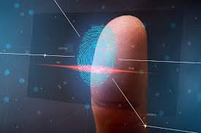
Introduction
The requirement gathering, Analysis, Design are all important but what should be done after that? The design and implementation of a database is critical since it holds data for running the system. Which type of database is best for our system.

Slide 4
01
Performance
Design Principles
NoSQL databases can deliver high read and write performance, which is critical for real-time data processing and immediate attendance updates.
Scalability
Horizontal scaling: NoSQL are designed to scale out by adding more adding more servers which is essential for handling large volume of users.
Flexible Schema: As the system evolves, the database schema can easily be modified.
Security
Flexible Security Models: NoSQL offers various security features like encryption as rest and in transit, fined grained control access.
Maintainance
Automated Management: NoSQL always comes with automated maintenance tools for tasks such as backup, recovery and monitoring.

Slide 5
01
Choose our DBMS
METHODOLOGY
02
Involves a structured approach to ensure scalability, performance, and flexibility in managing data
Design our Schemas
03
Model the data

Slide 6

01
Document Oriented Storage
Selected MongoDB
Nested Data Support
Scalability and Performance
Horizontal Scalability
Maintainance

Slide 7

02
User
Schema Design
Course
Session

Slide 8
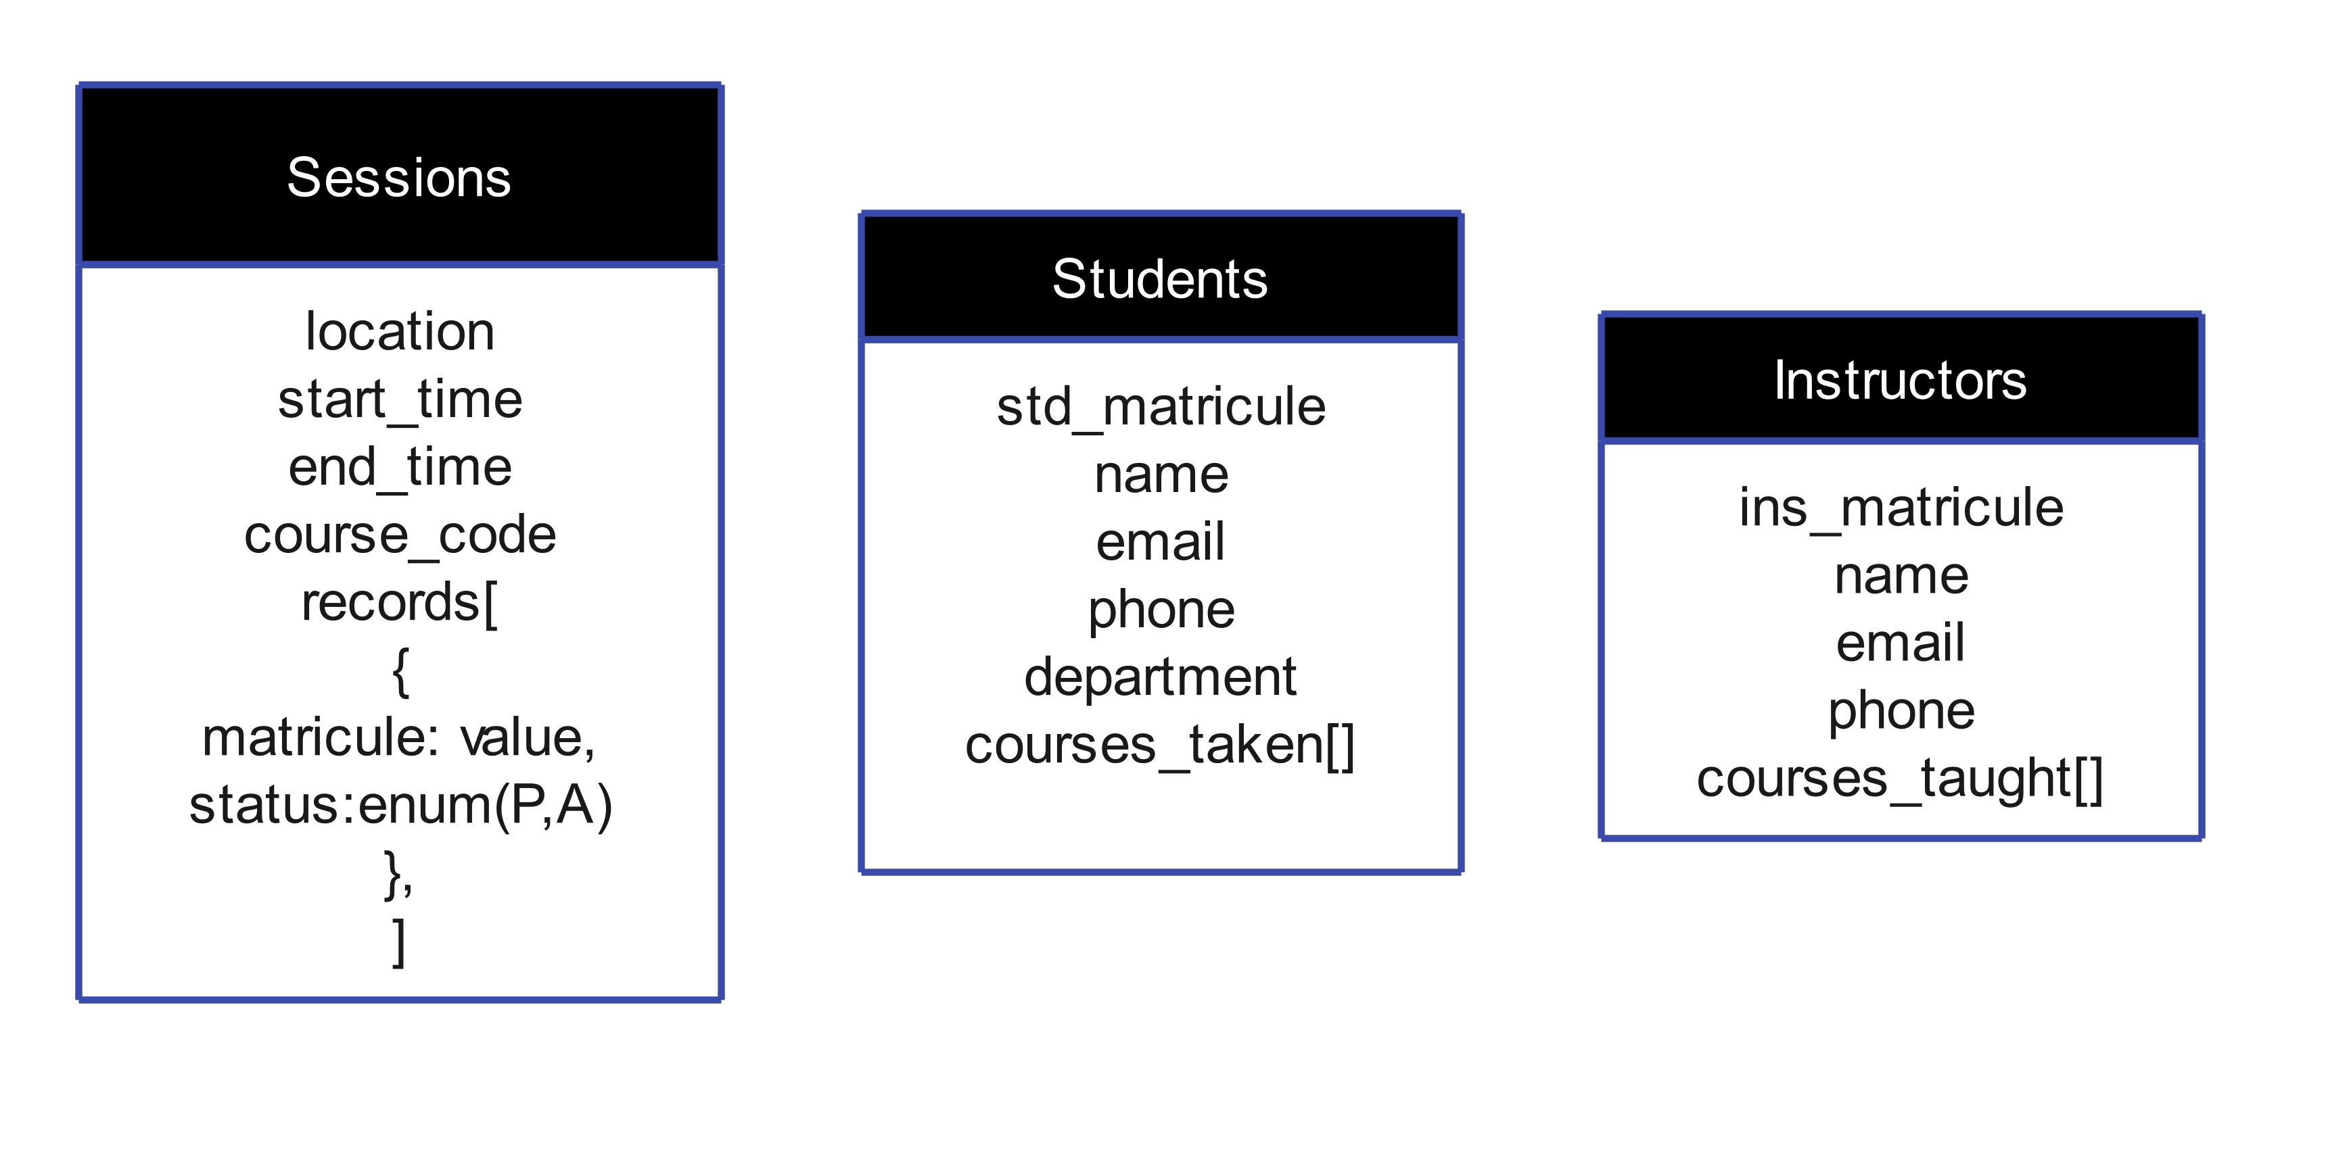
User - Course
Session - Course
Session - Student
02
Data Modelling

Slide 9
DATABASE DESIGN
01
Conceptual Design
02
The schema structure consists of interconnected collections designed to ease storage, retrieval and data management
Logical design
03
Physical Design

Slide 10

01
User
Conceptual Design
Course
Session
Notification

Slide 11
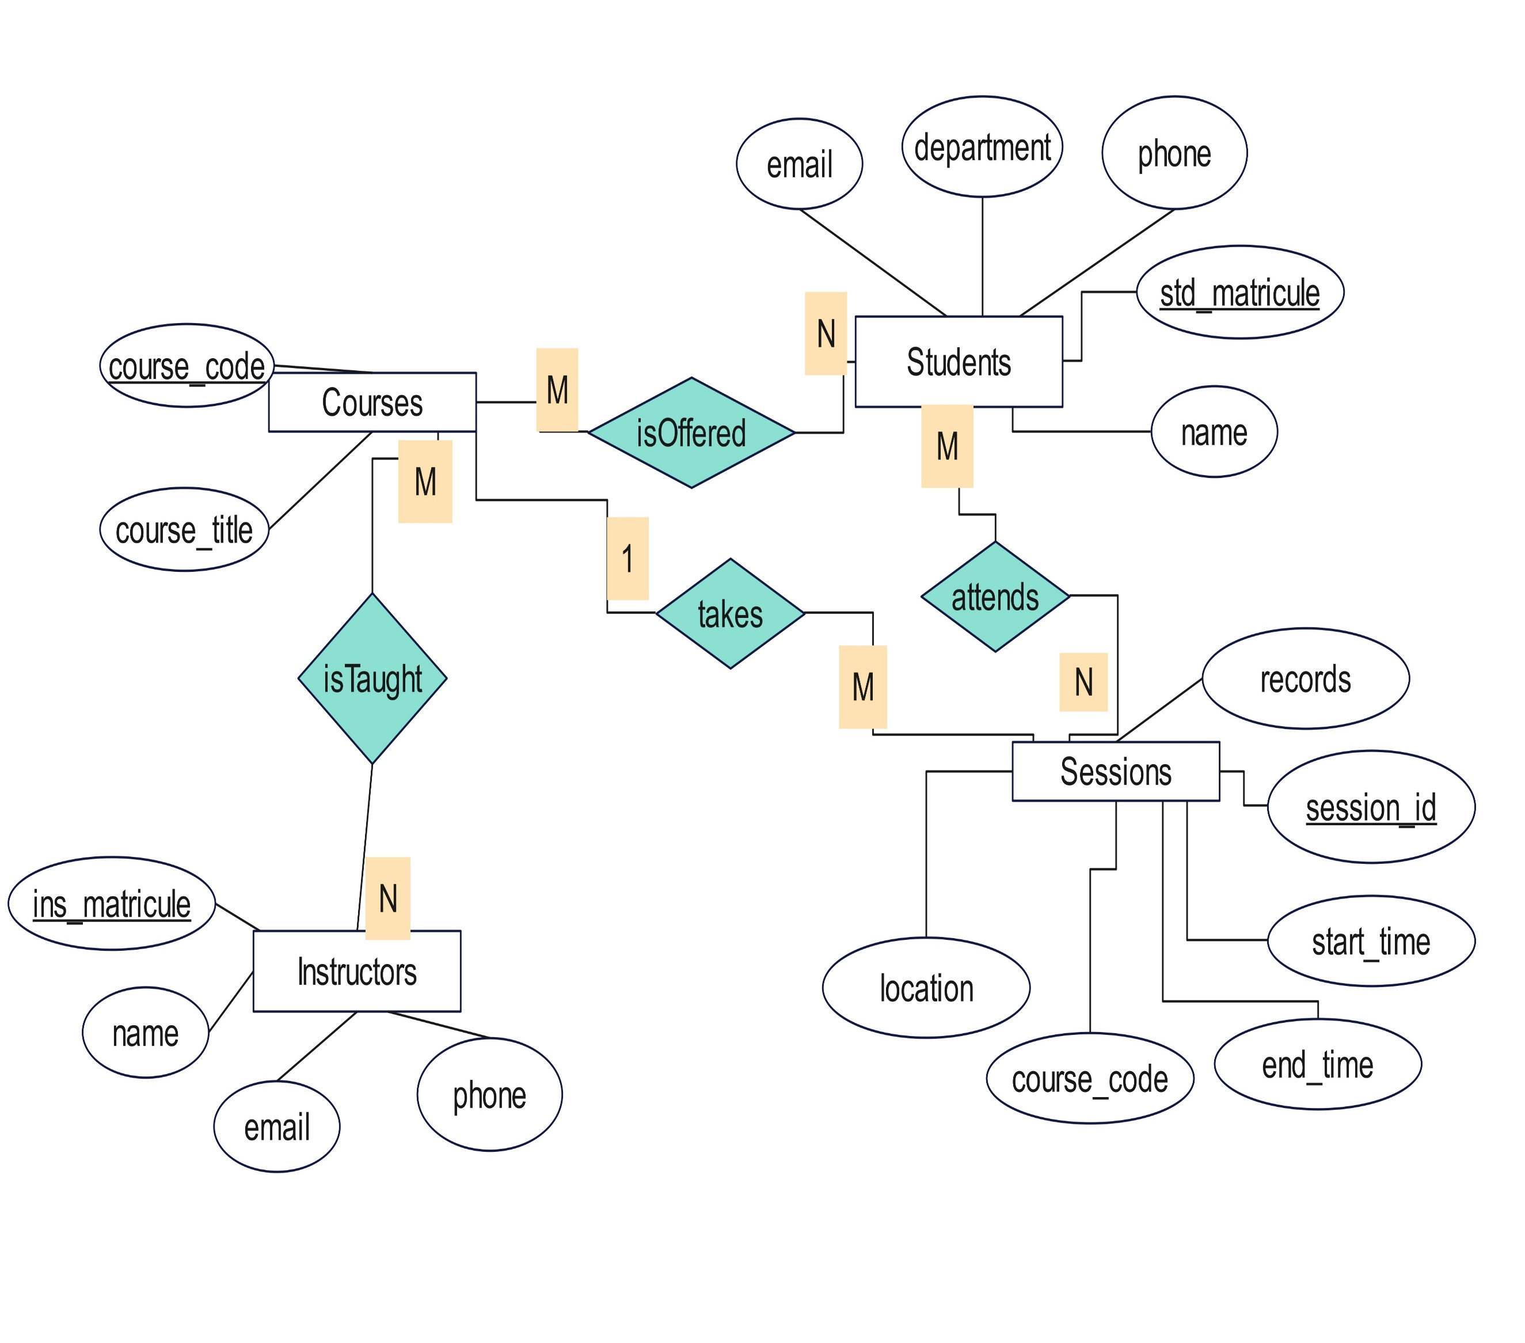
01
Conceptual Design

Slide 12
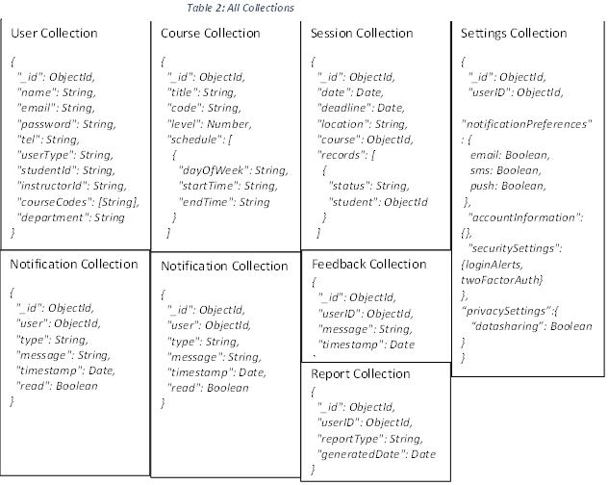
02
Physical Design

Slide 13

DATABASE IMPLEMENTATION
01
Tools:
MongoDB, Node.js, bcrypt, jwt, jest, nodemailer, express, validator
02
Implementation
03
Challenges Faced

Slide 14

02
Schema Definition using Mongoose
Implementation
RESTFUL API integration
Auth routes; signup, login and update profile
Attendance Module: intiate session, mark attendance, generate and report
Notification and Feedack: View and Send

Slide 15

03
Data Validation
Challenges faced
Error Handling
Security and Privacy
Environment Configuration
Notification

Slide 16
DATABASE TESTING
01
Test Cases
02
This phase involved various testing methodologies, including functional testing, security testing, performance testing
Test Results
03
Performance Considerations

Slide 17
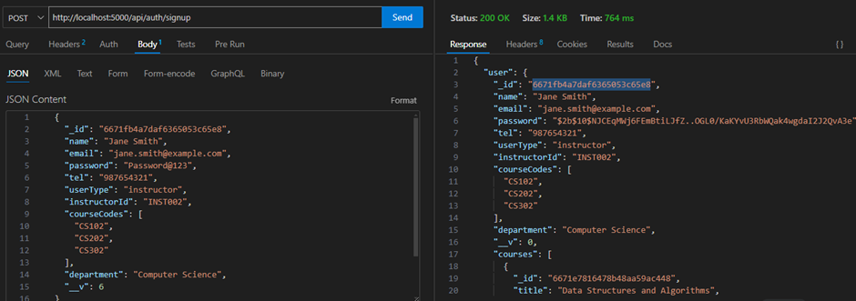
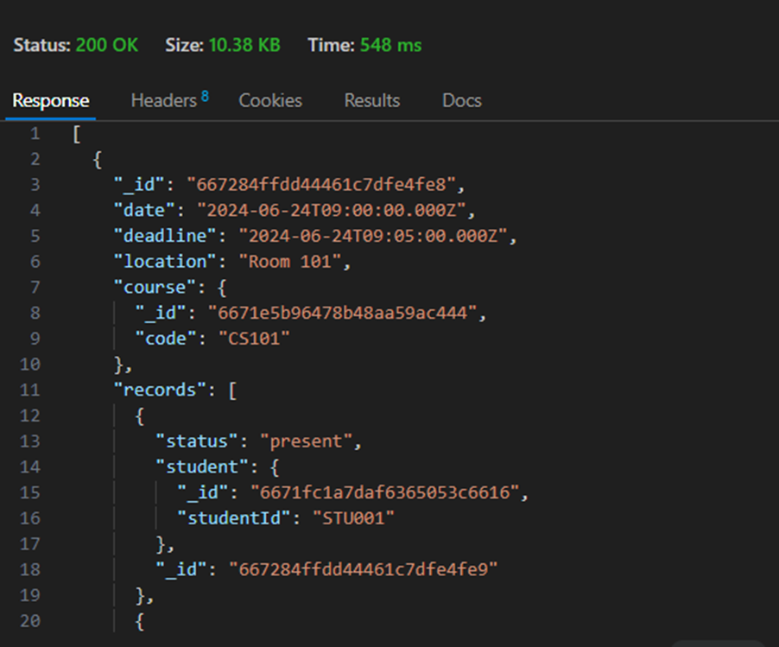
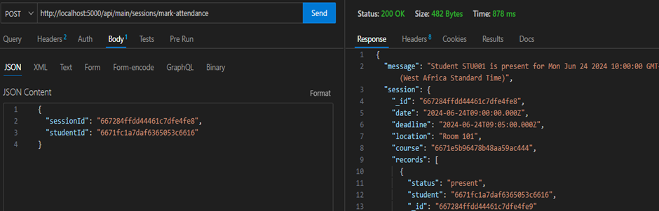
Operations such as signup, login, markattendance export reports with both correct and invalid data input.
01
Functional

Slide 18
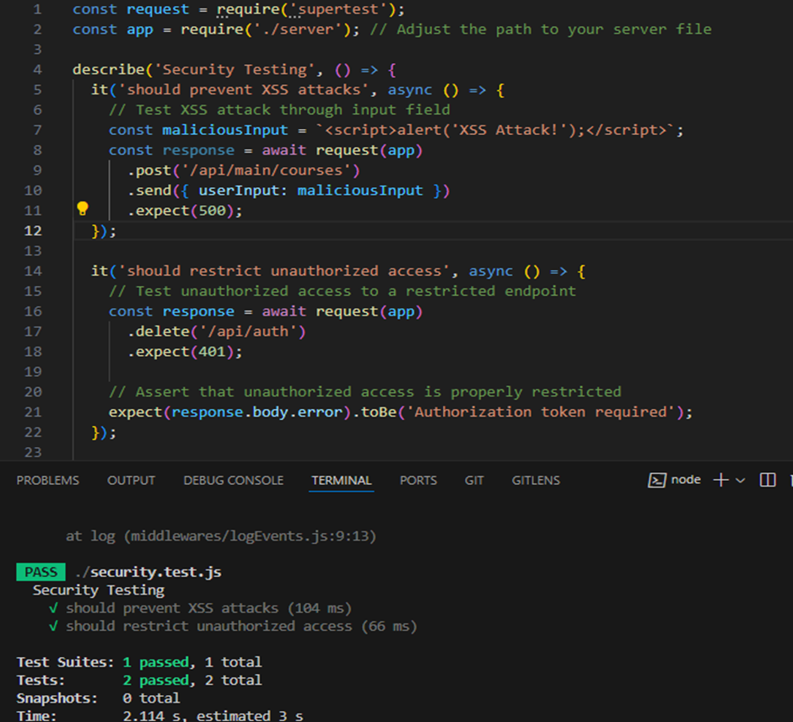
02
Security
Unauthorized Access
Malicious Input Handling
Data Protection

Slide 19
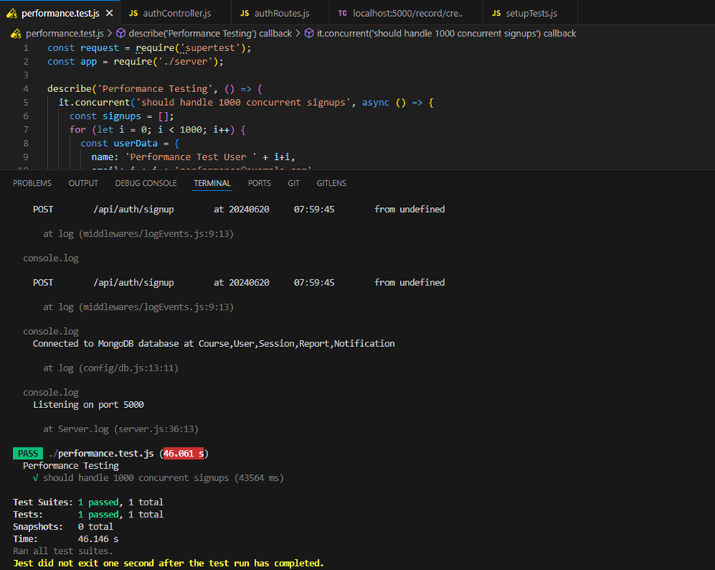

It took 40s to signup 1000 students
It took 40s to signup 100 student, create course and sesion then mark their attendance
03
Performance Testing

Slide 20


The summary of key findings.
We realized sensible information such as fingerprints is not allowed to be stored in any database.
Instead, we are going to use already stored and hashed fingerprints in the mobile device for our attendance tracking.

Slide 21

Optimizing Performance
Future Work
Integrating with frontend
Deployment and Maintaintance

Slide 22

THANK YOU
See you again soon!

